Slide 1
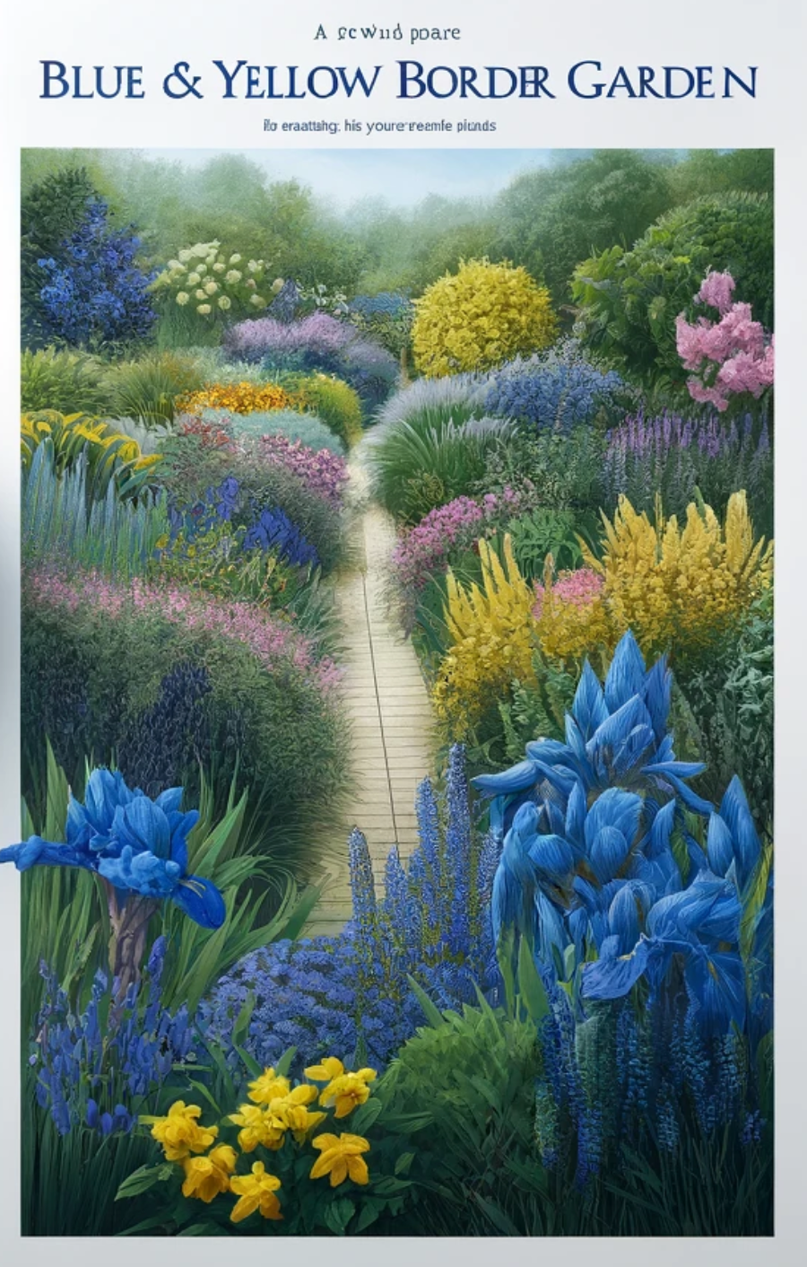
To design a Property Border Line Garden for your country cottage, we'll focus on creating a natural, inviting border that enhances the charm of your cottage while ensuring privacy and adding aesthetic appeal. This garden will be tailored to blend harmoniously with the rural setting, incorporating a mix of flowering shrubs, perennials, and decorative elements suitable for lining property boundaries.
Design Objectives
Privacy: Utilize taller plants and shrubs to create a natural screen.
Aesthetic Appeal: Choose plants that bloom in succession for year-round visual interest.
Low Maintenance: Select hardy plants suited to your local climate that require minimal upkeep.
Garden Layout and Planting Plan
Key Features
Hedging: For a structured yet natural border.
Mixed Flowering Borders: For color and variety.
Pathway Along the Border: For easy access and maintenance.
Front Row (Closest to the Pathway)
Moonbeam Coreopsis (Coreopsis verticillata 'Moonbeam'): Pale yellow flowers that bloom continuously throughout the summer, located along the edges of the wood chip pathway, providing a soft border. Wiki
Catmint (Nepeta spp.): Lavender-blue flowers, planted in clusters along the pathway, offering a cascading, relaxed look. Wiki
Husker Red Beard Tongue (Penstemon digitalis 'Husker Red'): Featuring white flowers atop deep red foliage, placed intermittently along the pathway to add height and color contrast.
Middle Row
Dark Knight Bluebeard (Caryopteris x clandonensis 'Dark Knight'): Deep blue flowers located in the middle sections of the planting beds, providing a striking visual contrast against the lighter foliage around them. Wiki
Coronation Gold Yarrow (Achillea 'Coronation Gold'): Golden yellow flowers on tall stems, placed in the middle to back sections of the garden beds, visible for their bright color and height.
Back Row (Near the Fences and Taller Structures)
Fat Albert Blue Spruce (Picea pungens 'Fat Albert'): A compact, cone-shaped evergreen, providing a year-round blue hue and structural height, positioned towards the back near the fence line. Wiki
Saybrook Gold Juniper (Juniperus x pfitzeriana 'Saybrook Gold'): With its vibrant gold foliage, this juniper is used as ground cover and for creating continuous color along the back border.

Slide 2
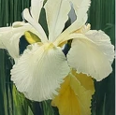
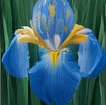
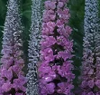
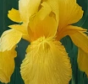

Plant list
PLANT NAME | TYPE | HEIGHT | SPREAD | SEASON | LIGHT | MOISTURE | HARDINESS | SOIL PH
Digitalis xmertonensis | perennial | 0.5-1 metre, 3-4 feet | 0.1-0.5 metre 1-2 feet | Summer | full sun/ partial shade /full shade | moist but well-drained | very hardy, USDA 4-9 | acid / alkaline / neutral
Nepeta grandiflora Dawn to Dusk' | perennial | 0.5-1 metre, 2.5 feet | 0.5-1 metre, 2.5 feet | Summer | full sun / partial shade / full shade | moist but well-drained | very hardy, USDA 9-11 | alkaline / neutral
Scabiosa atropurpurea 'Fata Morgana' | perennial | 0.5-1 metre, 3 feet | 0.1-0.5 metre, 1-2 feet | Summer | full sun / partial shade / full shade | well-drained | very hardy, USDA 2-11 | acid / alkaline / neutral
Daucus carota 'Dara | perennial | 0.5-1 metre, 3 feet | 0.1-0.5 metre, 3 feet | Summer | full sun | moist but well-drained | very hardy, USDA 5-9 | acid / alkaline / neutral
Knautia macedonica | perennial | 0.5-1 metre, 1.5-2 feet | 0.1-0.5 metre, 1.5-2 feet | Summer | full sun | well-drained | half hardy, USDA 6-10 | alkaline / neutral
Eschscholzia californica 'Ivory Castle' | perennial | 0.1-0.5 metre, 1-1.5 feet | 0.1-0.5 metre, 1-1.5 feet | Summer | full sun | well-drained | very hardy, USDA 4-9 | acid / alkaline / neutral

Slide 3
